Slide 1
Are We There Yet
Progress Report 4

Slide 2
Tasks Completed
Post Mortem 2
Sprint 3 Backlog
Parts and design research

Slide 3
Currently Working On
Final Parts List and Budget
Initial prototyping
Parts order

Slide 4
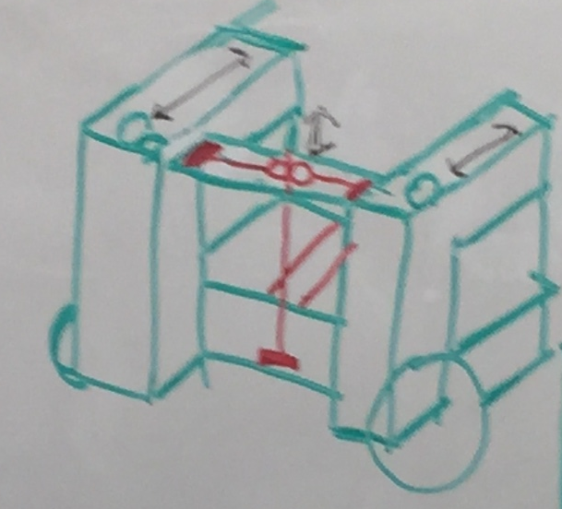
Current System Design

Slide 5
Looking Ahead
Parts Order
Prototype
Prototype testing
Level 2 Requirements

Slide 6
Major Budget Items
Udoo Microcontroller
Mecanum Wheels
Stepper and gear motors
Linear actuators
Camera
Chassis
Batteries

